Slide 1
A recommendation system for movies Presentation
Jordan Rey-Jouanchicot | Angelina Gasharova

Slide 2
Project analysis slide 2
Introduction
1.5 MILLION RATINGS
17 000 MOVIES
Netflix
Dataset
SIZE AROUND 2GB
SPARSE MATRIX
DATASET FOR A CONTEST
480 000 USERS

Slide 3
Project analysis slide 3
OUR APPROACH
HYBRID APPROACH
FEATURE ENGINEERING
HIGHER SCORE OVER LOWER
TECHNIQUE AND ALGORITHM
TECHNOLOGY AND CONNECTIONS
Using collaborative-filtering and "content-based" approach (user-centered)
To get information about users - like the number of movies they watched by months and use these
features to find similar users
We take the movies with higher recommendation score created using both systems.
For collaborative filtering we use ALS-WR, and for the “content-based” (user) part we decided to use KNN, to find similar users.
Hive metastore accessed by Hive and Impala + Pyspark because of its many ML solutions

Slide 4
Project analysis slide 4
Preparation
Environment preparation
Data preparation
Configure the VM from the labs
Setup a working Python environment
Match with a IMDB dataset
Adapt data files
Storage and SQL queries
Install PySpark
Use Livy to access it
Configure HUE
This is all documented and pushed in our repo.
See here on Github.
We tried to show how much data we could get from movies based on netflix titles and one IMDB database to improve our model in the future. We were able to match around half of the movies.
Customer Objectives
Setup internet
Get Python from sources
Get Pip from a script
Setup Python env var
via Livy
To be able to read them more easily, we wrote some scripts.
See here on Github.
We stored the data first in text files, then converted to Parquet.
We made SQL queries to extract probe data from training and to create a user table (using train_without_test data) for our “content-based” model.

Slide 5
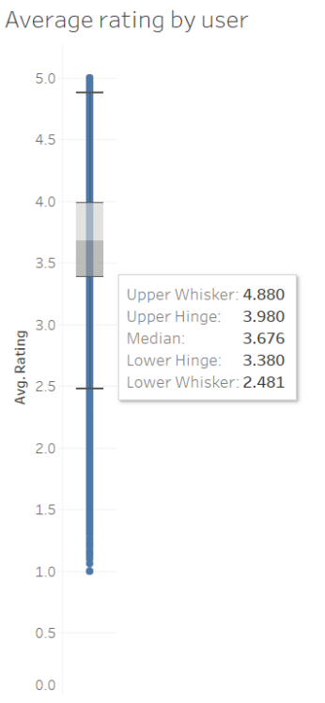
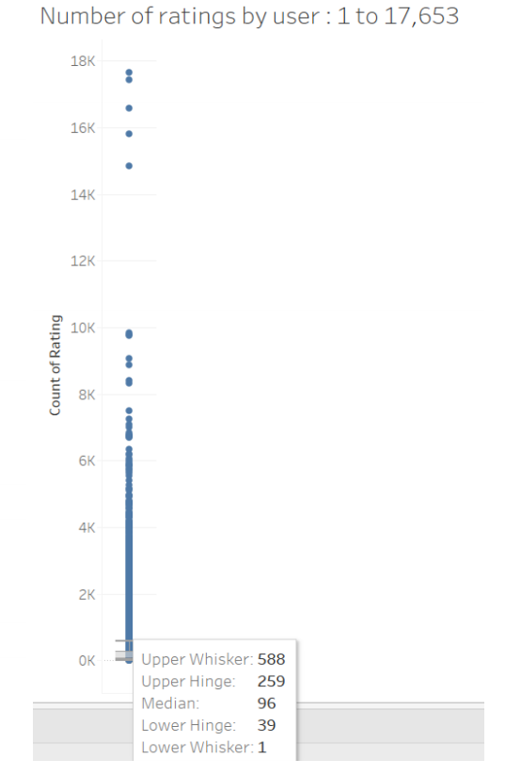
Project analysis slide 4
Data Visualization
There are some integrated visualization tools inside Cloudera, but we decided to connect to Impala through Tableau Software to do some visualization.

Slide 6
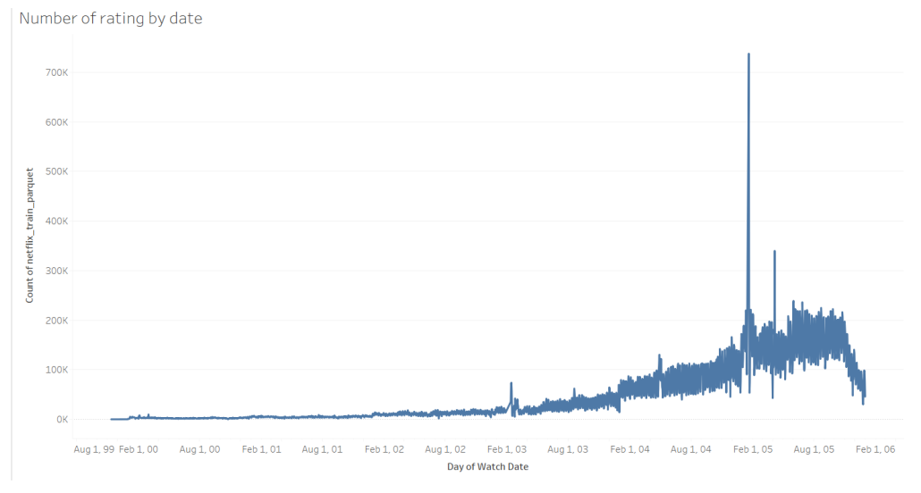
Project analysis slide 4
Data Visualization

Slide 7
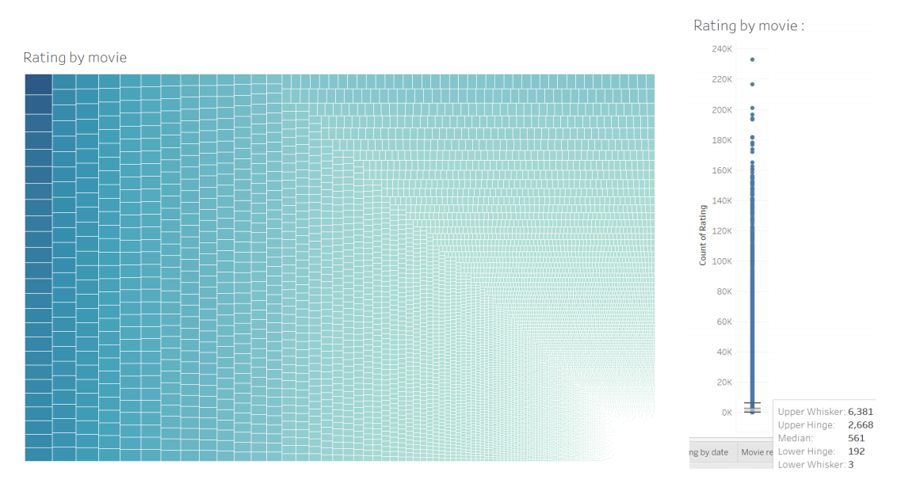
Project analysis slide 4
Data Visualization

Slide 8
Project analysis slide 10
Model & Result Analysis
We designed an algorithm to recommend movies to a selected user taking in account the maximum number of element to recommend, the maximum number of products for each similar user to consider, and the number of product to consider using KNN and ALS-WR recommendation algorithm. Our features to find similar users are : total_number_of_movie, average_rating, best_rating, worst_mark, average_movie_monthly
Training algorithms : 10 mins
Prediction : 2 à 5 mins (depend of parameters)
We spent hours trying to optimize partitions size, storage, java configurations, spark and yarn configurations, but even after this, we did not succeed to use on our single VM with more than 10 millions records, with more data an error was raising. It seems that the error is raised because it does not find a large enough continuous space in memory.
To analyse the results of the model, we focused on analysing results of the ALS part of our model, even if we were not able to use the full dataset, we implemented a method to calculate RMSE, because it was the metric used during Netflix competition. Our model using only 10 millions row got an RMSE on probe dataset of 1.16, results that we found on internet using similar methods on the full dataset are around 0.93 with the same number of features.
File was run as a HUE notebook. See here on Github.

Slide 9
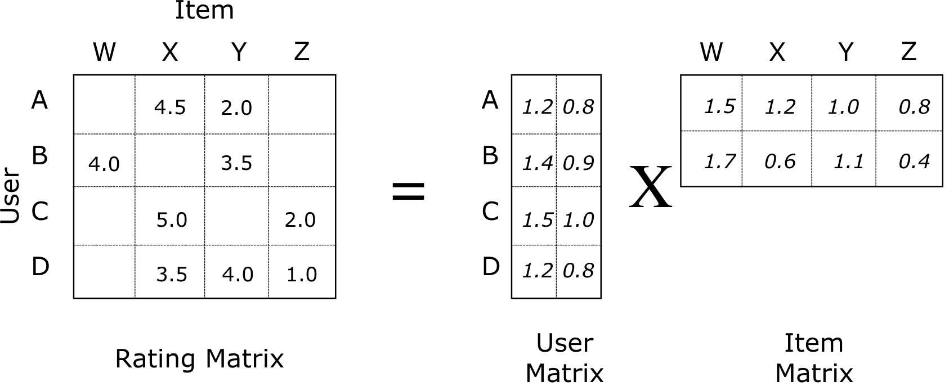
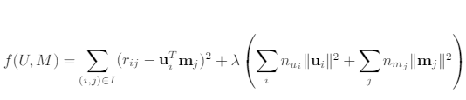

Project analysis slide 10
ALS and ALS-WR
Alternating Least Square :
Initialize matrix M by assigning the average rating for that movie as the ﬁrst row, and small random numbers for the remaining entries.
2. Fix M, Solve U by minimizing the objective function (the sum of squared errors)
3. Fix U, solve M by minimizing the objective function similarly
4. Repeat Steps 2 and 3 until a stopping criterion is satisﬁed (10 iterations in our case)
WR ? weighted-λ-regularization

Slide 10
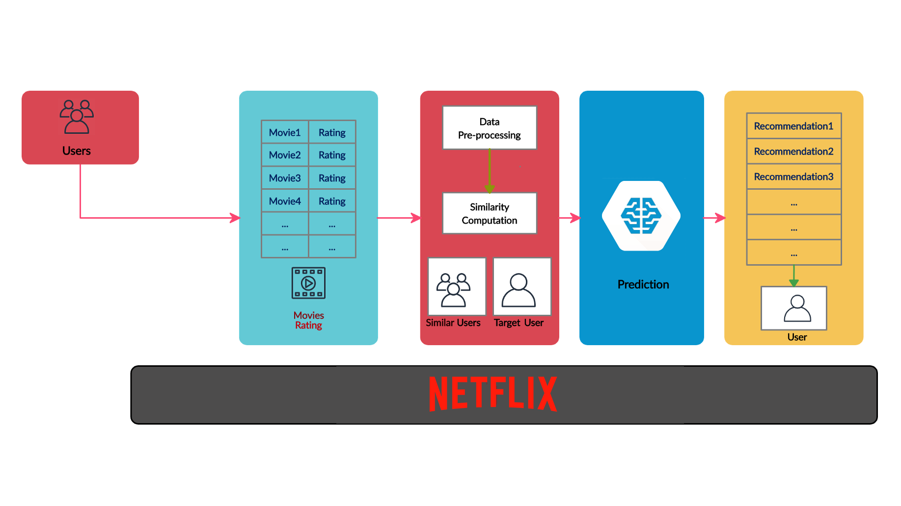
Project analysis slide 10
Our algorithm
Find closest neighbors (number defined in parameters when training KNN model) using KNN
For all this users get their N-favorite movie (N defined during call), sort all movies by rating
Get the K-movies with the best rating from this list (can be not distinct)
Get J recommended movies to the user using ALS
For the K-movies recommended by other users, value equal prediction rating of the user (ALS)
Each time the same movie appear from the K-List again: add one to value
For the J movies from ALS recommendation, either take the predicted value and record the movie in the list if It does not exist, else add 1.5 to previous value
Get the T number of movies to recommend (T define in parameter)
This is not how we implemented it but easier way to explain it
Cold Start strategy :
If user does not exist, then do not get any recommendation from ALS system, and get recommendation from similar users of a specified one (using our algorithm)

Slide 11
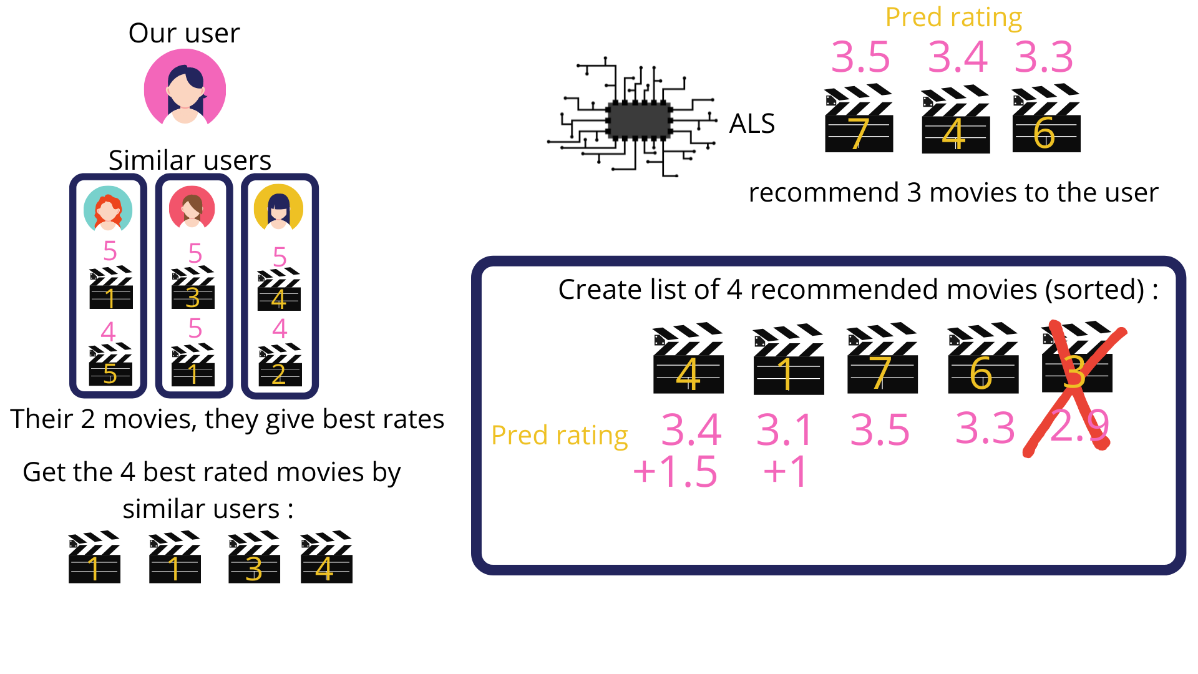

Slide 12
What could be interesting for the future
Create an API using our code and our environment allowing to get recommendations
Make a pipeline updating our rating database and retraining our models at a certain frequency, we could you kafka
Explore other way of getting recommendation like using reinforcement learning

Slide 13
Thank You

